Slide 1
Covid-19 Containment Zone Alerting Application
Team Id: PNT2022TMID23042
Team Members:
A.Rakesh
S.Sathiah Balaji
G.Ghulam Dasthageer
R.Vishal Raj
Project Mentor :
Mr.K.Azarudeen B.E,M.E
Department of Computer Science & Engineering
Velammal College of Engineering and Technology

Slide 2
Contents
Problem definition
Survey Papers
Existing Application
Hardware & Software Requirements
Objective
Department of Computer Science & Engineering
Velammal College of Engineering and Technology

Slide 3
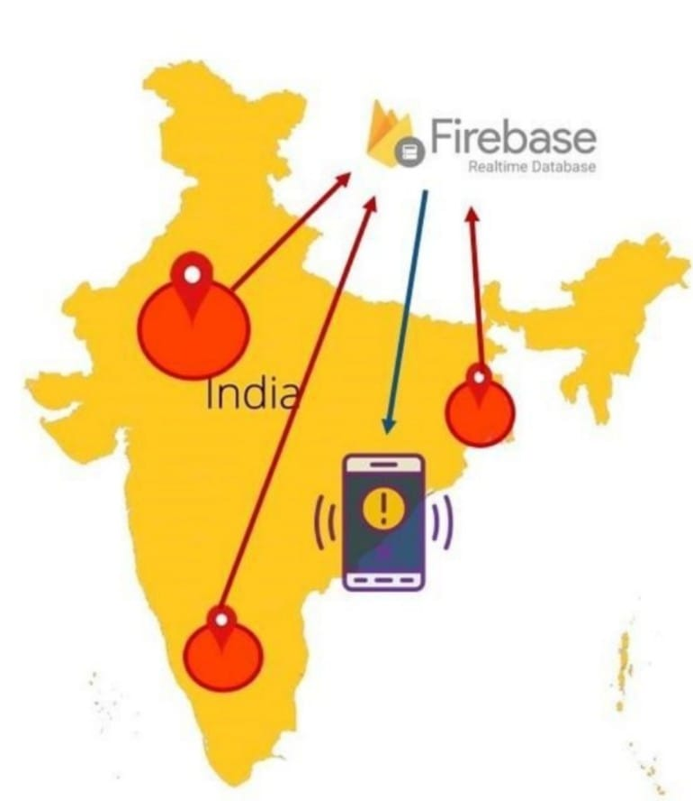
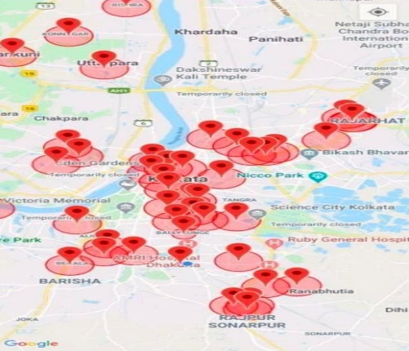
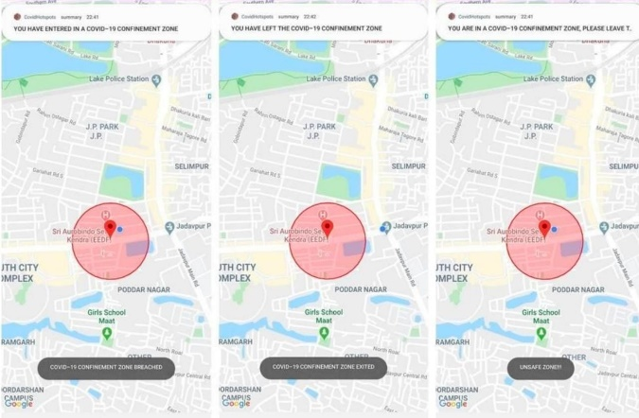
Problem definition
The project aims at building an application that provides information about the containment zones of a particular region by continuously monitoring an individual's location.
Location of the individual must be stored in the Database.
Alerts are sent using the notification service.
Department of Computer Science & Engineering
Velammal College of Engineering and Technology

Slide 4
Problem Definition
Features of the Application
Admin App(Portal)
They should login to the app and update the containment zones locations in the portal. Based on the location a Geofence will be created within a 100 meters radius. They should be able to see how many people are visiting that zone.
User App (Mobile App)
The app should have a user registration and login. After the user logged into the app it will track the user's location and update the database with the current location. If the user is visiting the containment zone he will get an alert notification.
Department of Computer Science & Engineering
Velammal College of Engineering and Technology

Slide 5
Survey Papers
Author Name : Amlan Protim Hazarika
Title : Development of an Android application for viewing Covid-19 containment zones and monitoring violators who are trespassing into it using Firebase and Geofencing
Publication website : https://www.ncbi.nlm.nih.gov/pmc/articles/PMC7328652/
Published Date : May 11th, 2020
Objective : This Android application shows the location of the containment zones to the users. It also notifies the user when he or she trespasses the boundary of a containment zone or stays in the containment zones. All these functionalities are achieved by the help of Firebase and Geofencing tools from Google
Technology used:
Firebase Cloud Firestore- A real-time database is created in Google Cloud Firestore which contains all the data related to the containment zones like latitudes, longitude, radius and zone names
Geofencing – A feature in a software program that uses the Global Positioning System(GPS) or radio frequency identification (RFID) to define geographical area
Department of Computer Science & Engineering
Velammal College of Engineering and Technology

Slide 6
Existing Application
Developed by : National Informatics Centre under the Ministry of Electronics and Information Technology (MeitY)
Title : aarogya setu
Publication website : https://play.google.com/store/apps/details?id=nic.goi.aarogyasetu&hl=en
Published Date : 2020
Objective : Aarogya Setu is a mobile application developed by the Government of India to connect essential health services with the people of India in our combined fight against COVID-19. The app is aimed at augmenting the initiatives of the Government of India, particularly the Department of Health, in proactively reaching out to and informing the users of the app regarding risks, best practices and relevant advisories pertaining to the containment of COVID-19
Functionality: It will give the daily database of covid patients getting admitted,discharged ,updation of positive and negative cases and deaths occuring in a day and also it gives the total database of the covid cases.
It also provide information of each and every person getting vaccinated.
It will provide database in provitional manner.
Department of Computer Science & Engineering
Velammal College of Engineering and Technology

Slide 7
Existing Application
Developed by : Rhys Fenwick
Title :Corona watch
Publication website : https://play.google.com/store/apps/details?id=com.ksrsac.drawshapefile&hl=en
Published Date : February 19, 2020
Objective : This app is for showing the locations of Corona Affected Patients and their movement history of 14 days. General Public can use this to identify their movements in those areas. If found to be in such locations, they are requested to call help line numbers The app also facilitates citizens to identify the nearest hospitals which can treat for coronavirus including the sample collection centers and testing labs.
Functionalies: It regularly sends two messages(12hrs each) for a day to the patients for checking about their status of their health condition.
Staffs are remotely monitored based on shift basis(12hrs each).
English and Spanish are the languages available in corona watch.
Department of Computer Science & Engineering
Velammal College of Engineering and Technology

Slide 8
Existing Application
Developed by : Government of Tamil Nadu
Title:COVID-19 Care Tamil Nadu
Publication website:https://play.google.com/store/apps/details?id=com.rvmatrix.corona&hl=en
Published Date : 2020
Objective : The application shows the district wise COVID-19 cases in Tamil Nadu. It also shows the containment zones of the state. It provides help line numbers and bed availability of Covid-19 hospitals in all the districts
Functionality: District wise- Detailed information on COVID Spread.
Containment zone indicator. Administrative information related to Covid and Lockdown.(Includes district wise press releases) Emergency contact information-- Interactive COVID related Question and Answers.Voice of People - Register your voice (in words) /Suggestions/ grievances. -- Video updates on various topics -- Access to Important government orders published by Govt of TN.-- Receive Alerts and notifications.-- English and Tamil Language support.
Department of Computer Science & Engineering
Velammal College of Engineering and Technology

Slide 9
Existing Application
Developed by: Mayank Bhangadia
Title:COVID19 connect
Publication website: https://play.google.com/store/apps/details?id=com.igib.COVID19Connect&hl=en
Published Date: 2020
Objective:
This app is developed as part of ongoing research on COVID-19. This app aims to provide relevant information on accessible resources for patient care. This app does not provide any clinical assistance (COVID19 Connect 2020)
Department of Computer Science & Engineering
Velammal College of Engineering and Technology

Slide 10
Existing Application
Developed by: Greater Chennai Corporation.
Title:GCC-Corona monitoring
Publication website:https://play.google.com/store/apps/details?id=com.gcc.smartcity&hl=en
Published Date: 2020
Objective:
GCC-Corona Monitoring is the offcial app for collecting data to curb the spread of COVID-19 by the Greater Chennai Corporation (GCC-Corona monitoring 2020) The application is limited to the people of Chennai, it can’t be opened by people outside Chennai. It provides information regarding Covid19 containment zones and isolation areas in Chennai
Department of Computer Science & Engineering
Velammal College of Engineering and Technology

Slide 11
Existing Application
Developed by : Government of Karnataka
Title : Quarantine watch
Publication website : https://play.google.com/store/apps/details?id=com.bmc.qrtnwatch&hl=en
Published Date : 2020
Objective : The application helps in self-reporting by the home quarantine persons and families. Stay home stay safe (Quarantine watch 2020) The application contains Karnataka health helpline numbers and helps in self reporting by home quarantined people.
Department of Computer Science & Engineering
Velammal College of Engineering and Technology

Slide 12
Existing Application
Developed by: Government of Uttar Pradesh
Title : Prayagraj COVID19 hotspots
Publicationwebsite:https://play.google.com/store/apps/details?id=com.prayagraj.covid19.hotspots&hl=en
Published Date : 2020
Objective : With the approval of administration, the COVID19 hotspots data are being collected to serve the community. An initiative from Data Live Technology. The app is published by Facewhiz Technologies (Prayagraj COVID19 hotspots 2020) The application could not be operated
Department of Computer Science & Engineering
Velammal College of Engineering and Technology

Slide 13
Existing Application
Developed by: Government of Rajasthan
Title : RajCovidInfo
Publicationwebsite:https://play.google.com/store/apps/details?id=com.gismcg.covid19_rajasthan&hl=en
Published Date : 2020
Objective : The application contains statistics of Covid-19 cases in Rajasthan and through this application the user can view the Covid Hotspots in Rajasthan and Covid-19 statistics. The application also provides updated information regarding Covid-19
Department of Computer Science & Engineering
Velammal College of Engineering and Technology

Slide 14
De-merits
The latest information about the containment zones are not updated regularly in the above mentioned applications.
The containment zone are limited according to the database available within the particular region and not according to the individual user’s location.
Department of Computer Science & Engineering
Velammal College of Engineering and Technology

Slide 15
Hardware & Software Requirements
Software Required : Python, Flask , Docker
System Required : 8GB RAM, Intel Core i3, OS-Windows/Linux/MAC, Laptop or Desktop
Department of Computer Science & Engineering
Velammal College of Engineering and Technology

Slide 16
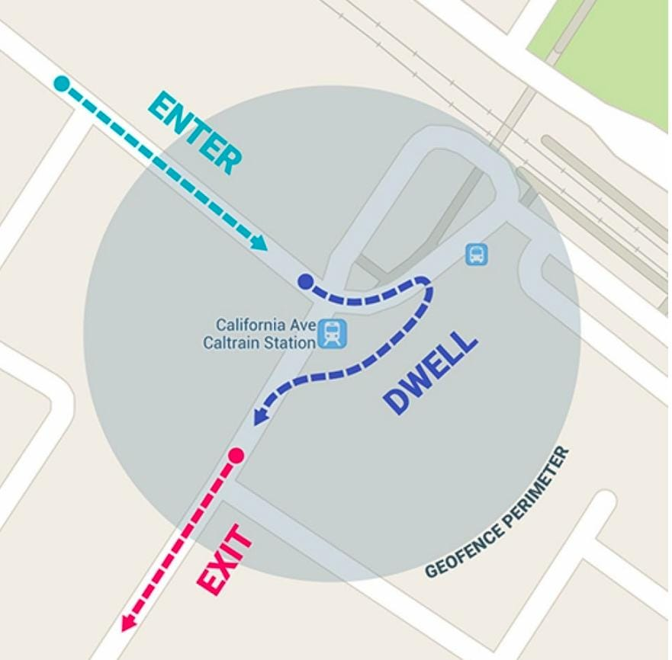
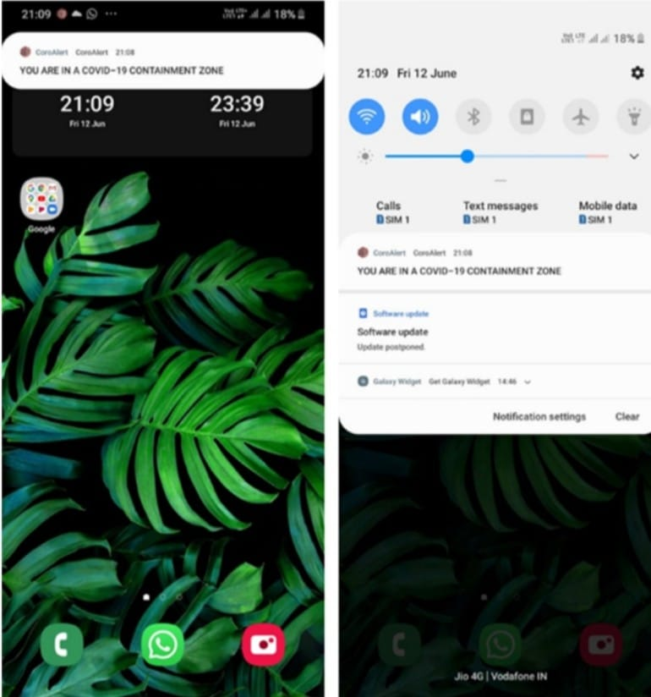
Objective
To provide information about containment zones through continuous updation of covid cases of each and every individual in a particular region.
Key benefits of the application are monitoring people's activity and alerting them for their safety movements according to the current location.
Department of Computer Science & Engineering
Velammal College of Engineering and Technology

Slide 17
Thank You!
Department of Computer Science & Engineering
Velammal College of Engineering and Technology

